Slide 1
PROBLEM STATEMENT
Introduction to GenAI and Simple LLM Inference on CPU and finetuning of LLM Model to create a Custom Chatbot

Slide 2
Idea Brief (Solution) :
Problem: The need for a quick and easy-to-use chatbot for basic information and queries.
Solution: A chatbot application built using Streamlit, Langchain, and Hugging Face Hub.

Slide 3
Features Offered:
Real-time interaction: Instantaneous responses to user queries.
Customizable system prompts: Users can tailor the chatbot's behavior.
Natural language understanding: Ability to process and understand human language.
Leverage of pre-trained models: Utilizes advanced language models from Hugging Face Hub.

Slide 4
Process Flow:
User enters a query in the Streamlit interface.
Query is processed by Langchain.
Prompt is constructed using the system prompt and user query.
Prompt is sent to the Hugging Face model.
Model generates a response.
Response is displayed in the Streamlit interface.

Slide 5
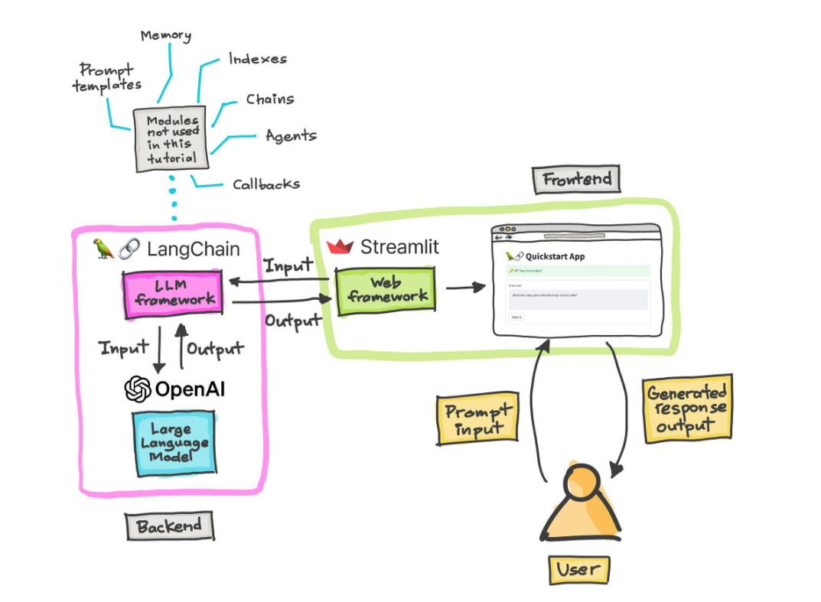
Architecture Diagram:

Slide 6
In the above diagram :
1 Streamlit: handles user interface and input/ouput
2 Langchain:manages prompt engineering and llm interaction
3 Hugging face hub : provides access to pre trained language models

Slide 7
Technology Stack:
Streamlit: For building the user interface and handling user interactions.
Langchain: For managing the prompt engineering and LLM interaction.
Hugging Face Hub: For accessing pre-trained language models.
Python: As the primary programming language.

Slide 8
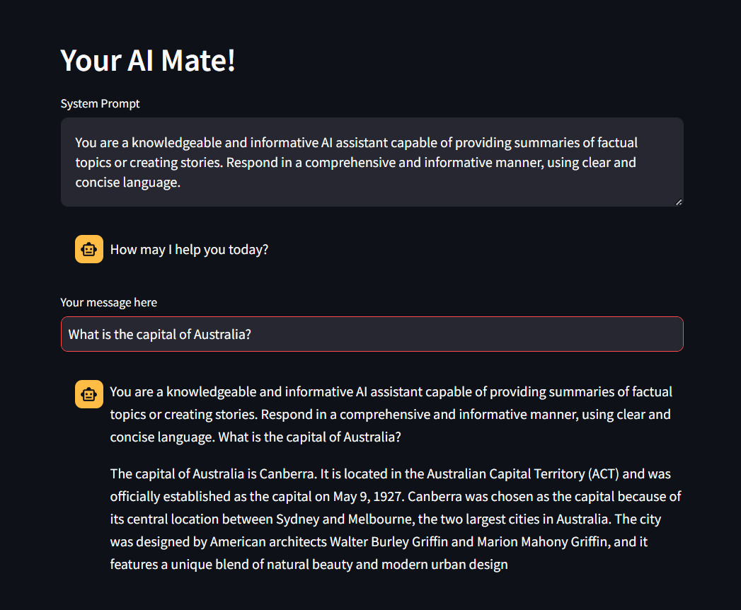
Demo:

Slide 9
Conclusion:
In conclusion, we have developed a chatbot application that leverages the power of Streamlit, Langchain, and Hugging Face Hub to provide users with quick and informative responses. By effectively combining these technologies, we have created a chatbot capable of understanding and responding to user queries in a natural and engaging manner.
This chatbot offers a promising foundation for future development, with potential enhancements such as expanded knowledge bases, more complex conversation flows, and advanced features like sentiment analysis. We believe this chatbot has the potential to revolutionize the way users interact with information and services.

